Slide 1

Detection and Prevention of Vehicle Insurance Claim Fraud Leveraging Machine Learning for Accurate Fraud Detection Machine Learning Fundamentals (AAI-510)
Team 1:
Outhai Xayavongsa (Thai) – Lead
Aaron Ramirez
Muhammad Haris
Notes:
Good Day everyone. Welcome to our presentation on "Detection and Prevention of Vehicle Insurance Claim Fraud.”
I am Muhammad Haris, presenting on behalf of our team. Our project lead is Outhai Xayavongsa, and our technical team leader is Aaron Ramirez.
Together, we have worked diligently to develop a reliable predictive model that leverages historical data to identify fraudulent claims effectively.
Today, we will guide you through our approach, key findings, and actionable recommendations.
Let's delve into how we can enhance the security and trustworthiness of our insurance system through advanced machine learning techniques.

Slide 2

Understanding the Problem
Insurance fraud costs companies millions annually, impacting profitability and premium rates for honest customers.
Detecting fraudulent claims promptly and accurately is crucial for minimizing financial losses and maintaining customer trust.
In 2022 in the United States alone, the insurance industry generated over $276 billion in revenue.
Fraudulent claims affect many trades such as tourism and dining and account for almost $23 billion in tax revenues.
This Photo by Unknown Author is licensed under CC BY-ND
Notes:
Let's take a moment to understand the gravity of the issue we're dealing with—insurance fraud.
Insurance fraud costs companies millions of dollars annually, impacting profitability and premium rates for honest customers. This not only affects the bottom line of insurance companies but also places a financial burden on policyholders, leading to higher premiums and reduced customer satisfaction.
Detecting fraudulent claims promptly and accurately is crucial for minimizing financial losses and maintaining customer trust. By swiftly identifying and addressing fraudulent activities, we can enhance operational efficiency and foster a fair, transparent environment where our customers feel valued and protected.
In 2022 alone, the insurance industry in the United States generated over $276 billion in revenue, with vehicle insurance being a significant contributor. Fraudulent claims not only affect insurance companies but also impact related industries such as tourism and dining, and account for a substantial portion of the nearly $23 billion in tax revenues.
Understanding the problem is the first step towards solving it. By acknowledging the significant financial and reputational impact of insurance fraud, we can appreciate the importance of our project’s objective—developing a reliable model to detect and prevent fraudulent claims. This initiative is not just a technical endeavor but a strategic move to safeguard our business and our customers.

Slide 3
Executive Summary
Detection and Prevention of Vehicle Insurance Claim Fraud
Problem Statement | How can vehicle and policy data be leveraged to accurately detect and prevent fraudulent insurance claims?
Project Objective | Primary Goal: Develop a reliable predictive model to identify fraudulent claims. Benefits: Reduce financial losses. Enhance operational efficiency. Boost customer trust. This project aims to accurately detect and prevent fraudulent insurance claims using historical data.
Notes:
Fraudulent claims not only lead to significant financial losses for insurance companies but also undermine the trust and fairness of the entire insurance system. These fraudulent activities can range from staged accidents to exaggerated personal injury claims, making the claims process more complicated and expensive.
Our key question is: How can vehicle and policy data be leveraged to accurately detect and prevent fraudulent insurance claims?
This question is at the heart of our project, as we aim to find a robust solution to this pervasive problem.
The primary goal of our project is to develop a reliable predictive model that can accurately identify fraudulent claims using historical data. This model is designed to:
Reduce Financial Losses: By identifying fraudulent claims early, we can prevent unnecessary payouts, saving the company significant amounts of money.
Enhance Operational Efficiency: Streamlining the claims process by quickly flagging potentially fraudulent claims allows for faster and more efficient handling of legitimate claims.
Boost Customer Trust: Ensuring that only valid claims are paid helps maintain fair premium pricing and increases trust among policyholders.
In summary, this project aims to use historical data to develop a model that accurately detects and prevents fraudulent insurance claims, thereby protecting the financial health of the company and ensuring fairness for our customers.

Slide 4
Dataset Analysis
Dataset Overview
Understanding
Data
Data Cleaning
Encoding & Scaling
Data Source: Kaggle
Checking Missing Values is crucial as they can impact the performance of machine learning models.
To ensure data integrity and suitability for model training, it's essential to comprehend the data's structure, types, and initial statistics.
Converted categorical variables into numerical formats and standardized numerical features
33 variables
Categorial & Numerical
Variables
Notes:
Dataset Overview:
In this section, we provide a high-level summary of the dataset. This includes the number of records, the types of features (such as numerical and categorical variables), and any initial observations about the data's distribution and structure. Understanding the scope and content of the dataset sets the foundation for further analysis.
Understanding Data:
Here, we conduct a more in-depth examination of the data. This involves exploring the relationships between features, identifying any potential patterns, and understanding the context of each variable. For example, we look at how different features correlate with the target variable, which in this case is the presence of fraud. This step helps us identify which features might be most predictive of fraudulent claims.
Data Cleaning:
This crucial step involves handling missing values, correcting any inaccuracies, and addressing outliers that could skew our model's performance. By ensuring the data is clean and accurate, we improve the quality and robustness of our model. For instance, we might fill missing values using statistical methods or remove records that contain erroneous data.
Encoding & Scaling:
In the final section, we transform the data into a format suitable for machine learning algorithms. This includes encoding categorical variables into numerical values and scaling numerical features to ensure they are on a similar scale. Proper encoding and scaling help enhance the performance and efficiency of the machine learning models.
Together, these steps provide a comprehensive understanding of our dataset and prepare it for effective modeling. By thoroughly analyzing and preparing our data, we can ensure that our models are built on a solid foundation, leading to more accurate and reliable fraud detection."

Slide 5
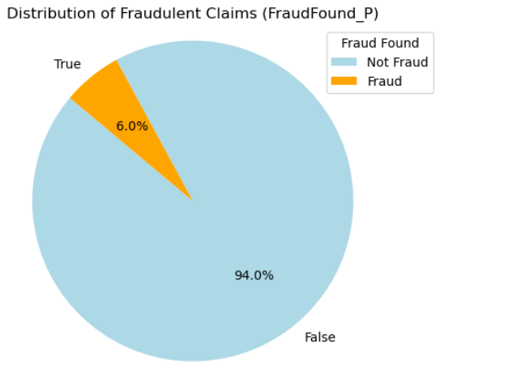

Exploratory Data Analysis
94% of claims are legitimate.
6% of claims are fraudulent.
Significant class imbalance.
Importance of accurate fraud detection.
Challenges posed by rare fraudulent claims.
Necessity of robust models.
Notes:
Thank you, Muhammad!
Let's start our exploratory data analysis by examining the distribution of fraudulent claims in our dataset. As depicted in the pie chart, a substantial majority, 94%, of the claims are legitimate, while only 6% are identified as fraudulent. This significant class imbalance presents a considerable challenge for accurately detecting fraud. The rarity of fraudulent claims necessitates the use of highly robust and precise models to ensure effective identification. Detecting these rare fraudulent claims among a large volume of legitimate ones is critical for minimizing financial losses and maintaining the integrity of the insurance system. Our analysis and model development efforts are thus focused on addressing this imbalance to enhance fraud detection accuracy.

Slide 6
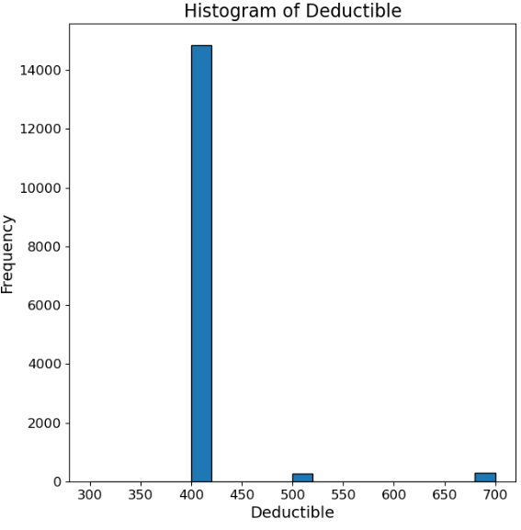
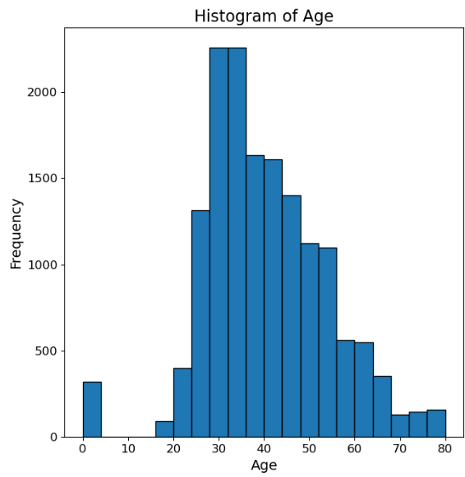
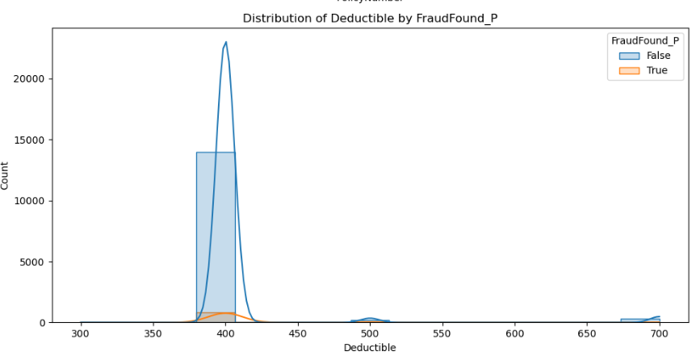
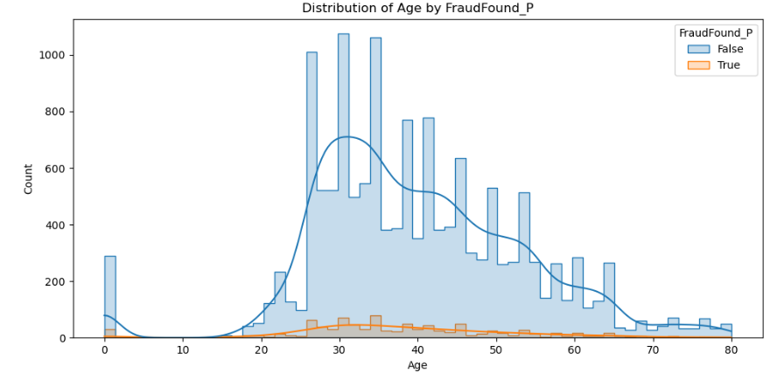
Feature Analysis
Deductible: High concentration at 400.
Age: Most claims are from ages 20-50.
Fraud by Deductible: Slight difference between fraudulent and non-fraudulent.
Fraud by Age: Higher fraud in ages 25-35.
Deductible Distribution: Peaks around 400.
Age Distribution: Right-skewed, peak at 30-35.
Insights for Model: Guide feature engineering and model tuning.
Visualization Importance: Understanding feature impact on fraud.
Notes:
Moving on to our feature analysis, we begin with the histogram of deductible amounts, which shows a high concentration around 400 suggesting that most claims have a deductible amount of 400. Next, we examine the age distribution of claimants, which reveals that the majority of claims come from individuals aged 20 to 50, with a notable peak around 30 to 35 years old. When we look at the distribution of deductibles by fraud status, we observe only slight differences between fraudulent and non-fraudulent claims. However, the age distribution by fraud status provides more insight, showing a higher incidence of fraud among individuals aged 25 to 35. This information is crucial for guiding our feature engineering and model tuning efforts. By understanding the impact of these features on fraud, we can make more informed decisions about which features to include in our models and how to preprocess them to enhance detection accuracy. Visualizing these distributions helps us comprehend the underlying patterns and informs our approach to building robust predictive models.

Slide 7

Feature Engineering
Vehicle Age
Age Group
Extracted key features based on EDA insights.
Applied one-hot encoding for categorical variables.
Scaled numerical features for consistency.
Handled missing values and data imbalances.
Implemented SMOTE for class imbalance.
Ensured data integrity and preprocessing.
Enhanced model performance with engineered features.
Deductible
Fault
Past Claims
Sex
Base Policy
Policy Type
Vehicle Category
Vehicle Price
Notes:
In our feature engineering process, we began by extracting key features from our dataset based on insights gained during exploratory data analysis. These features were selected due to their potential impact on detecting fraudulent claims. To prepare the data for modeling, we applied one-hot encoding to categorical variables, converting them into a format suitable for machine learning algorithms. For numerical features, we used scaling to ensure they had a consistent range, which is crucial for many machine learning models. Additionally, we addressed missing values and handled data imbalances using techniques like SMOTE (Synthetic Minority Over-sampling Technique) to balance the classes. Ensuring data integrity through thorough preprocessing steps was a priority. This included verifying the correctness of data types and managing any anomalies. By engineering these features and applying robust preprocessing techniques, we aimed to enhance our model's performance, making it more effective at identifying fraudulent claims. This comprehensive approach to feature engineering and data preparation is critical for building reliable and accurate predictive models.

Slide 8
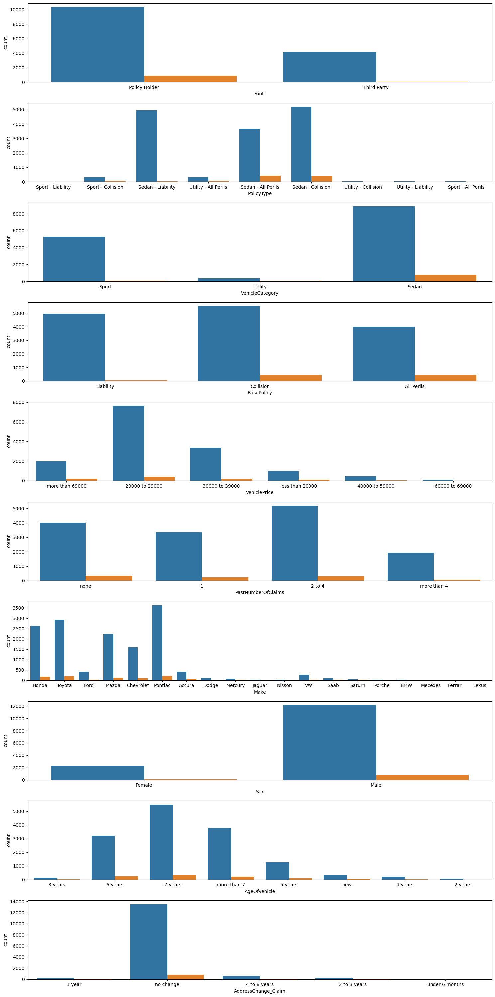
Feature Selection
Selected Features:
Age of vehicle
Age groups 18 - 50
Past number of claims
Vehicle price
Vehicle category
Base policy
Fault
Deductible
Policy type
Sex
Enhanced model performance by focusing on features with the highest predictive power.
Selected 10 key features.
Used Chi-square and T-tests for selection.
Domain knowledge guided feature selection.
Visualized feature distributions.
Focused on features with strong fraud associations.
Optimized model input with relevant features.
Notes:
In our feature selection process, we identified 10 key features that were crucial for detecting fraudulent claims. These features were selected based on the results of Chi-square and T-tests, as well as domain knowledge. The selected features included age of vehicle, age groups 18-50, past number of claims, vehicle price, vehicle category, base policy, fault, deductible, policy type, and sex. We visualized the distributions of these features to understand their impact on fraud detection better. For instance, we noticed that certain age groups and vehicle categories had stronger associations with fraudulent claims. These insights guided our feature selection, ensuring that we included features with the most significant influence on fraud detection. By focusing on these relevant features, we optimized our model's input, making it more effective in identifying fraudulent claims. This careful selection process ensures that our models are not only accurate but also efficient in processing and analyzing the data. The combination of statistical tests and domain knowledge provided a robust foundation for selecting the most impactful features for our models.

Slide 9
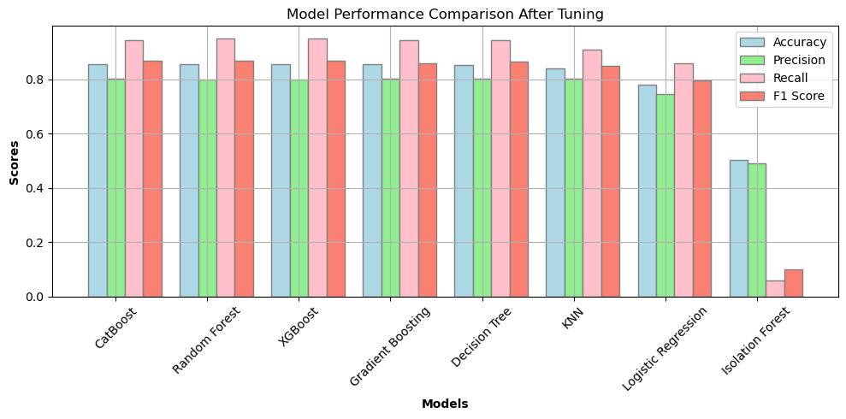
Model Development
Model Development:
Approaches Explored
Isolation Forest
Gradient Boosting Model
Decision Tree Classifier
XG Boost
Random Forest
K-Nearest Neighbor
Logistic Regression
CatBoost
Objective: To compare different models and select the best performing one based on accuracy and other metrics.
Notes:
With our data ready, we trained various machine learning models to detect fraudulent claims.
The models we trained included Isolation Forest, Gradient Boosting, Decision Tree, XGBoost, Random Forest, K-Nearest Neighbor, Logistic Regression, and CatBoost.
Each of these models brings a different approach to the table, helping us to understand the nuances of our dataset.
We evaluated these models using key metrics such as accuracy, precision, recall, and F1 score.
These metrics provided a comprehensive view of each model’s performance, allowing us to identify which model best balanced the need for identifying fraudulent claims without raising too many false alarms

Slide 10
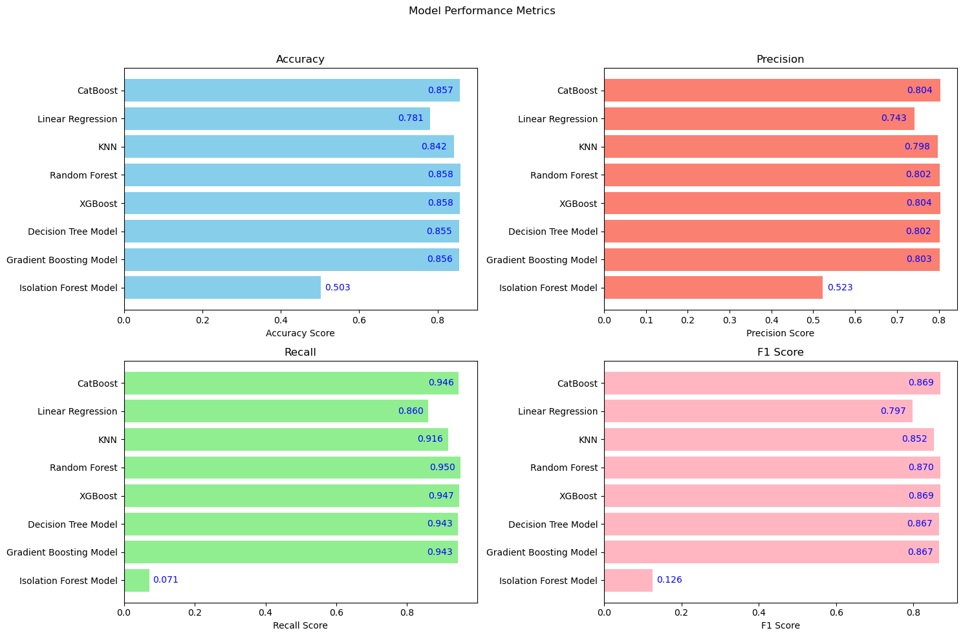
Model Evaluation
Model Evaluation:
Evaluation Metrics:
Accuracy
F1-score
Precision
Recall
The CatBoost model emerged as the top performer across all the key metrics.
It demonstrated significant improvement in fraud detection, making the most suitable model for deployment.
Significance of CatBoost Model:
Handling of Categorial Data
Robust Performance
Imbalance Handling
Notes:
After training our models, we compared their performance based on the evaluation metrics. The graph here provides a visual comparison of each model's accuracy, precision, recall, and F1 score.
Starting with accuracy, CatBoost achieved the highest score at 86%, closely followed by Random Forest and XGBoost. Precision, which measures the accuracy of positive predictions, showed similar results with CatBoost leading at 80%.
Recall, an indicator of how well the model identifies actual positives, saw CatBoost once again at the top with a remarkable score of 0.946. Finally, the F1 score, which balances precision and recall, highlighted CatBoost as the leader at 87%.
Isolation Forest, while useful for anomaly detection, showed significantly lower performance across all metrics. This indicates it's not suitable for our fraud detection needs.
Given these results, we selected CatBoost as our primary model for detecting vehicle insurance fraud due to its superior performance across all key metrics.

Slide 11

Conclusion
Summary of Findings
CatBoost emerged as the best model for detecting fraudulent vehicle insurance claims.
Other models like Random Forest and XGBoost also showed robust performance.
Isolation Forest was not suitable for this specific task.
Key Metrics
CatBoost achieved the highest accuracy, precision, recall, and F1 score.
Performance metrics for other models indicated they are also viable options.
Implications
Implementing these models can significantly reduce financial losses due to fraud.
Improved fraud detection leads to fairer premium pricing and better customer trust.
Notes:
In conclusion, our comprehensive analysis of multiple AI models for detecting fraudulent vehicle insurance claims highlighted the CatBoost model as the top performer across all key metrics, including accuracy, precision, recall, and F1 score.
This indicates its superior capability in accurately identifying fraudulent claims. Models like Random Forest and XGBoost also demonstrated strong performance, making them viable options.
However, the Isolation Forest model did not perform well and is not suitable for this specific task.
Implementing these models can help insurance companies reduce financial losses, streamline claims processing, and maintain fair premium pricing, ultimately fostering better customer trust.

Slide 12
Societal Impacts
Implementations and Recommendations
Deploy CatBoost Model
Primary model for fraud detection.
Supplementary use of Random Forest or XGBoost for robustness.
Continuous Monitoring and Retraining
Regular updates to adapt to evolving fraud patterns.
Ensure sustained model performance.
Integration with Claims Processing System
Seamless integration to automate fraud detection.
Enhances efficiency and accuracy in processing claims.
Financial Protection
Reduced financial losses for insurance companies.
Lower premiums for customers due to reduced fraud.
Customer Trust
Fair and transparent claim processing.
Enhanced customer satisfaction and loyalty.
Industry Standards
Setting a benchmark for fraud detection in the insurance industry.
Encouraging other companies to adopt similar technologies.
Notes:
Recommendations:
We recommend deploying the CatBoost model as the primary tool for detecting fraudulent vehicle insurance claims due to its superior performance. To ensure robustness, Random Forest or XGBoost can be used as supplementary models.
Continuous monitoring and periodic retraining of these models are essential to adapt to evolving fraud patterns and maintain their effectiveness.
Additionally, integrating these models with the claims processing system will automate fraud detection, enhancing both efficiency and accuracy in handling claims.
Societal Impacts:
Implementing advanced AI models for fraud detection has significant societal impacts.
Firstly, it provides financial protection by reducing losses for insurance companies, which can result in lower premiums for customers. This enhances the affordability of insurance.
Secondly, the fair and transparent processing of claims builds customer trust, leading to higher satisfaction and loyalty.
Lastly, by setting a benchmark for fraud detection, we can encourage other companies within the industry to adopt similar technologies, driving overall improvements in the insurance sector's standards and practices.

